Slide 1

Neural Networks
RECAP

Slide 2
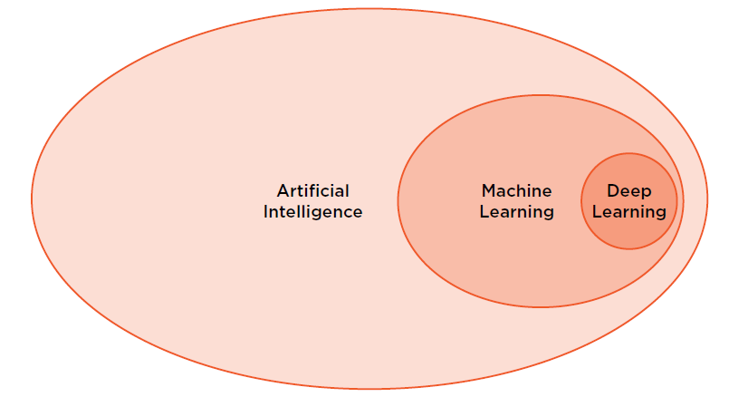
Setting the scene

Slide 3
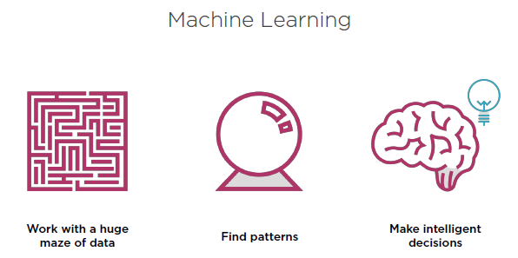
Notes:
‘Old’ way of thinking about Machine Learning

Slide 4
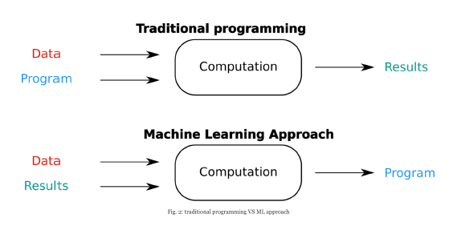
Notes:
Data driven approach: not just feeding data to machine, but using resulting effects back into the mix

Slide 5
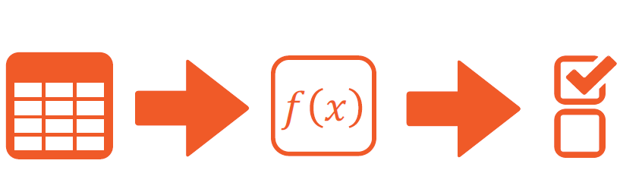
High Level pipeline ML
Notes:
§ Data driven
· High level pipeline
o Worldly problem needs to be fixed/solved à collect data that might be related to the problem (link to iot, robotics, data mining) – noisy, sampling rate, combining data from different places,… à Data inputs = X (aka corpus)
o X à ‘solve my problem algorithm’ à output Y, result, solution to the problem
§ Not solved, or not well enough? Need more, or different data? Another algorithm?
§ Feedback = loss or cost function (used by supervised learning to optimize learnable parameters)

Slide 6
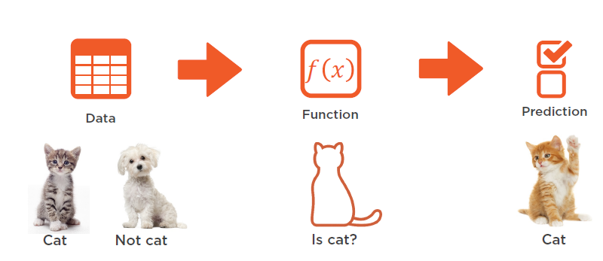

Slide 7
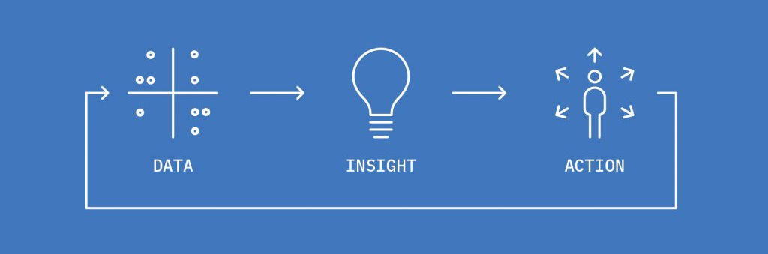
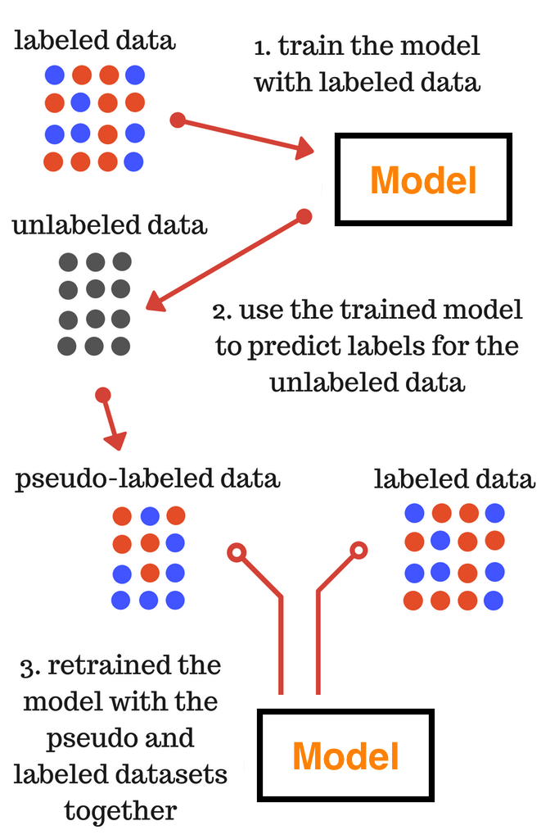
Data Driven
Getting data
IoT sensor data?
Image sensors - camera, sound sensors, heat sensors, motion sensors, text data
Noisy data?
Sampling rate?
Combining data from several places?
Labelling data
Amazon Turk
Re-captcha
Automatic clustering tools

Slide 8
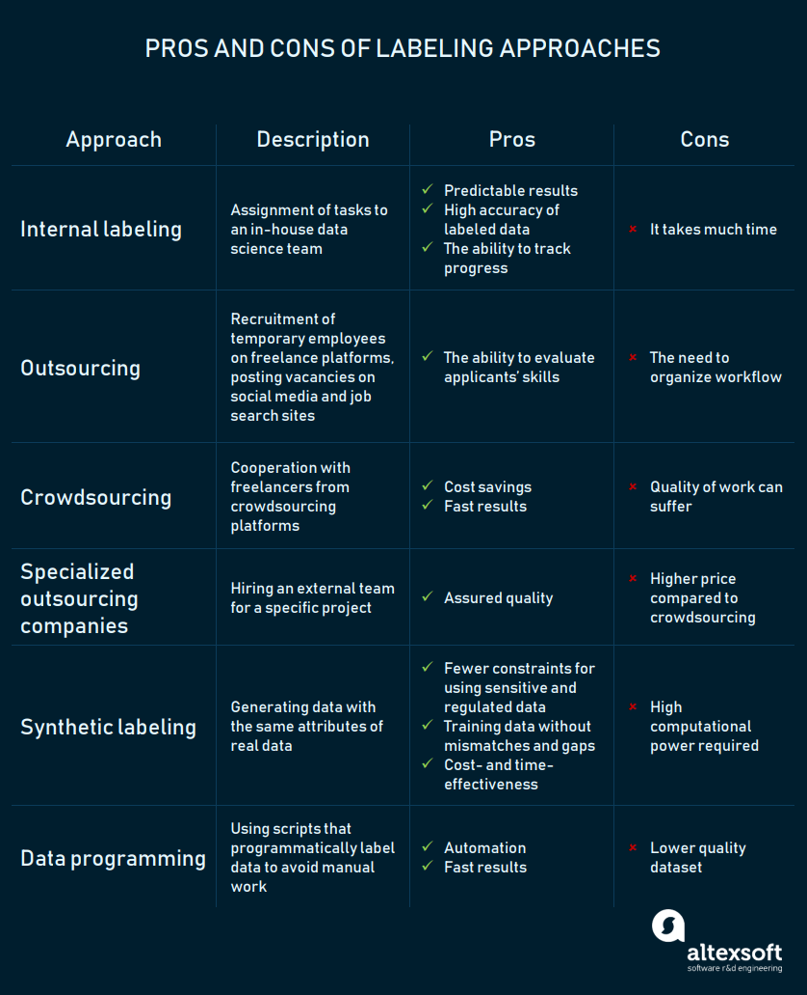

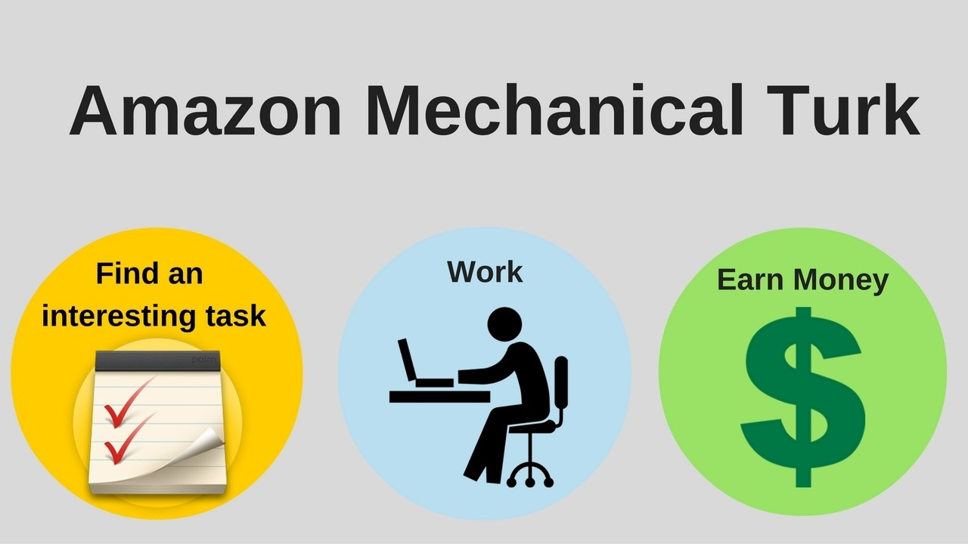

Slide 9
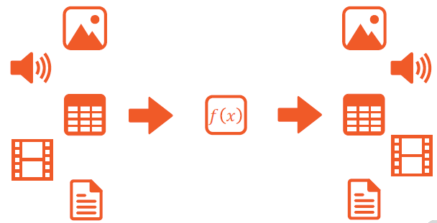

Notes:
Traditioneel was het van tabular data naar tabular data.
Tegenwoordig is de data ‘high densitity’ op informatie vlak → image bevat enorm veel data, text is ook een voorbeeld met enorm veel data inhoud → traditionele modelleringstechnieken zijn vandaag de dag niet voldoende voor die high information data streams → deep neural nets are an answer
Let wel op: daarom zijn neural nets niet altijd de beste approach. Decision trees, random forrests, XGradient boosting, SVM: allemaal nog legit algorithms om iets op te lossen → zie scikit learn cheat sheet
Vandaag gaan we van gelijk welke input, naar gelijk welke output → generative models

Slide 10
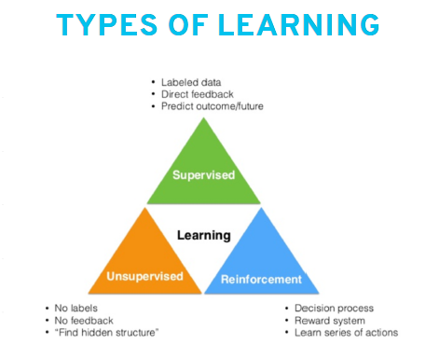

Slide 11
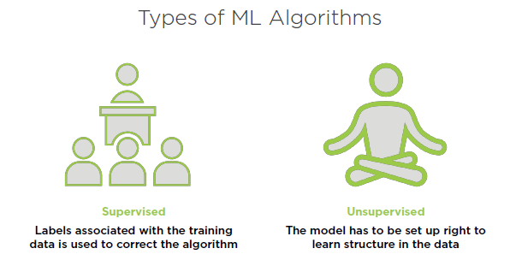
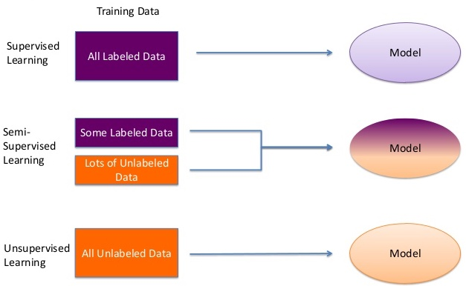

Slide 12
Types of problems / algorithms
Regression
Classification
Dimensionality reduction (PCA)
Clustering (kNN,...) → Data mining and knowledge discovery, recommendation engines
Anomaly detection
…
Many many tools, which one to use? Or more than one,
Ensemble learning
Bagging, boosting, XGBoosting, GA’s

Slide 13
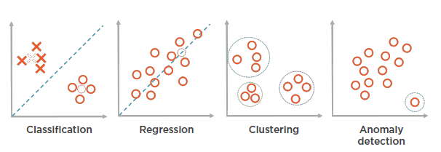

Slide 14
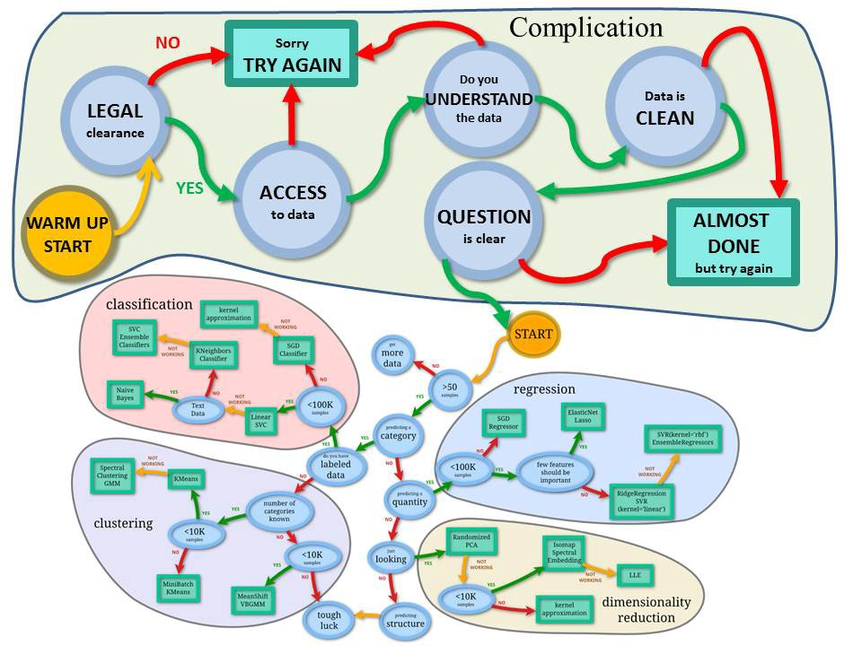
Notes:
Scikit learn cheet sheet

Slide 15
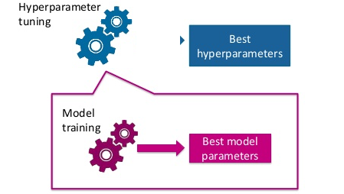
Hyperparameters - parameters
Hyperparameters (part of model design) versus regular, trainable parameters
Hyperparameters: grid search, random search, heuristic search

Slide 16
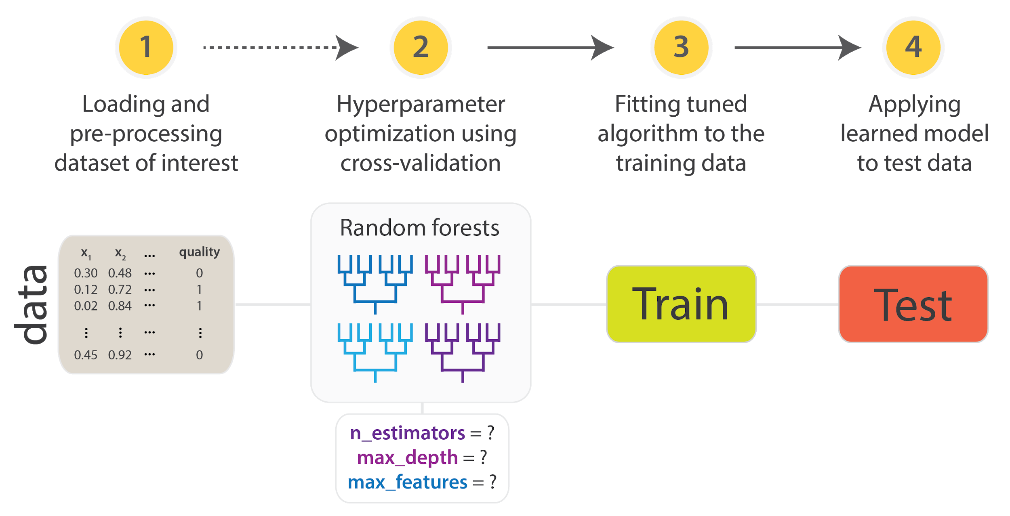

Slide 17
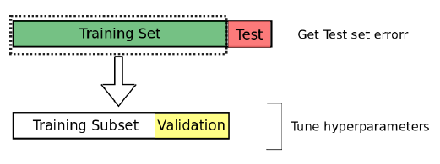
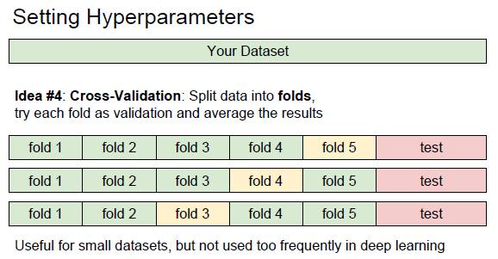

Slide 18
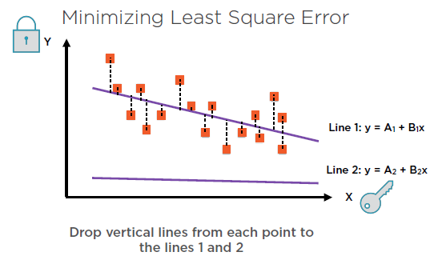
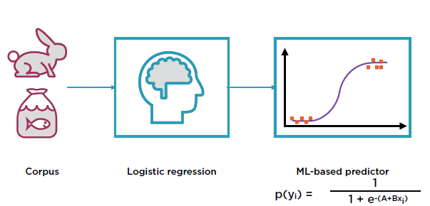
“Goodness of a model”
→ during (supervised) training phase aka “Loss function”
Regression Classification

Slide 19
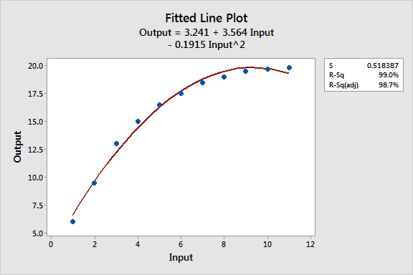
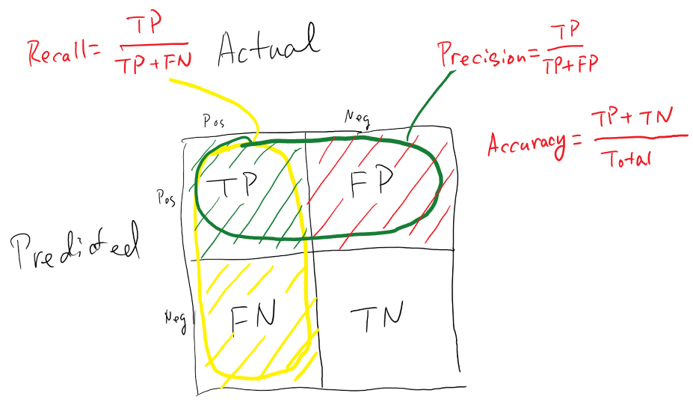
“Goodness of a model”
→ during test phase, final scoring
Regression Classification
Notes:
Regression: R2, F1score, SSE (sum square residual error),... → ofcourse there’s a relationship with the loss function, like MSE (mean square error) → don’t need to know exactly what they are, you need to know how to work with them when needed → easy: higher means ‘better’. In Kaggle scoring metrics will be provided, so you can check which metric you should choose, to get best test results…
Classification: confusion matrix. Note: don’t have to know by heart, but you have to be able to work with: accuracy, recall, precision, sensitivity, specificity, roc curve, auc curve,... when needed

Slide 20
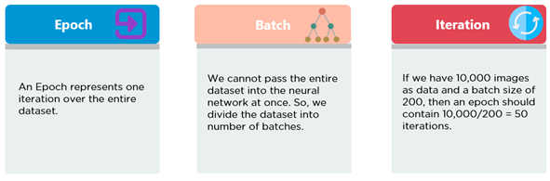
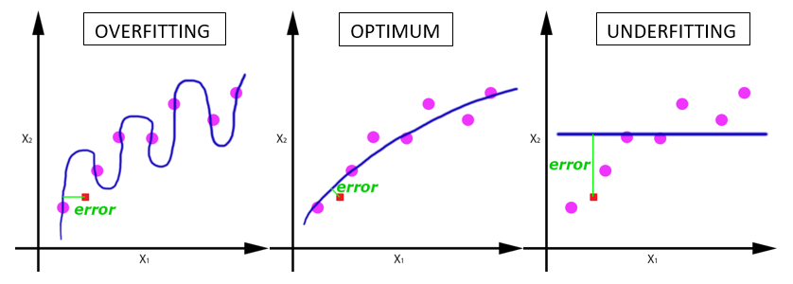

Slide 21
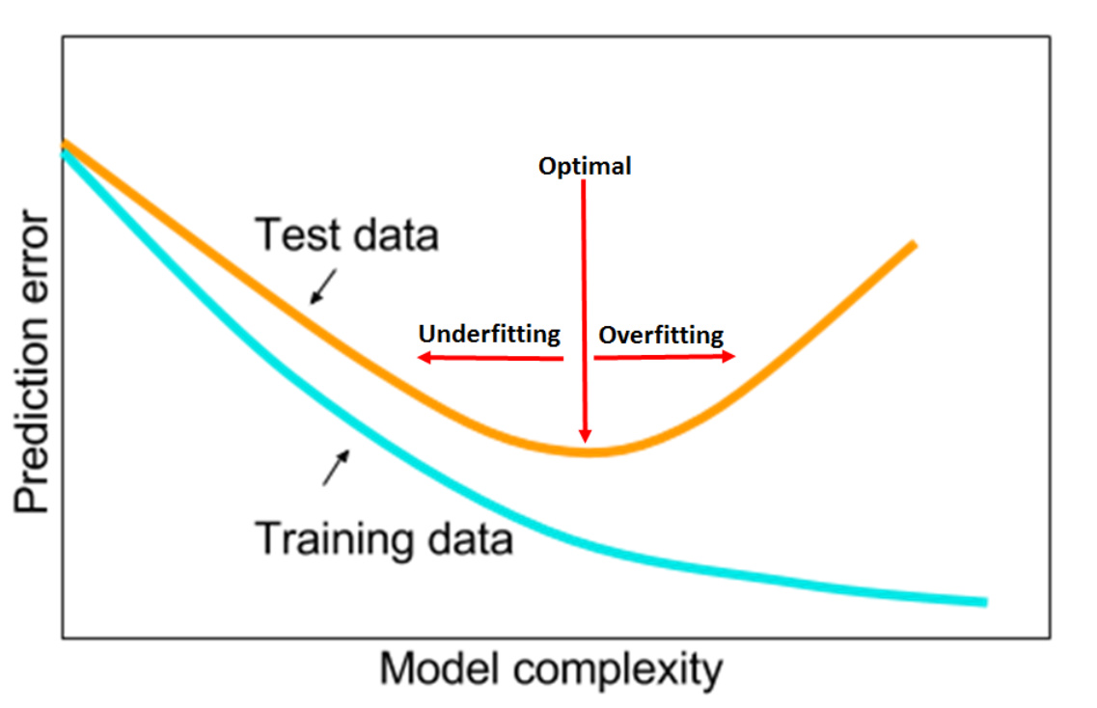

Slide 22
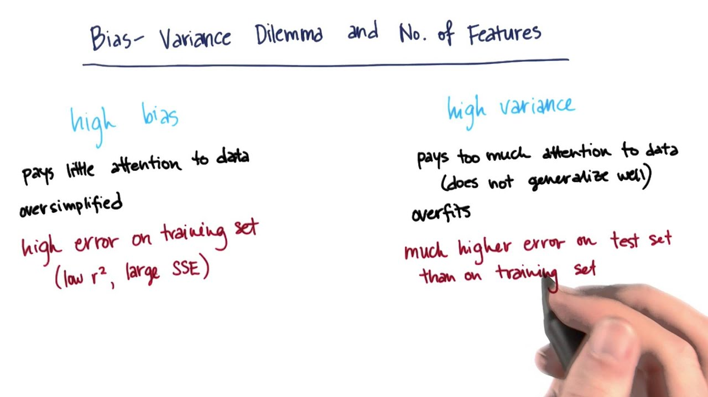
Notes:
Occam’s razor
Bias in model / algorithm
Generalize ←→ Specialize

Slide 23
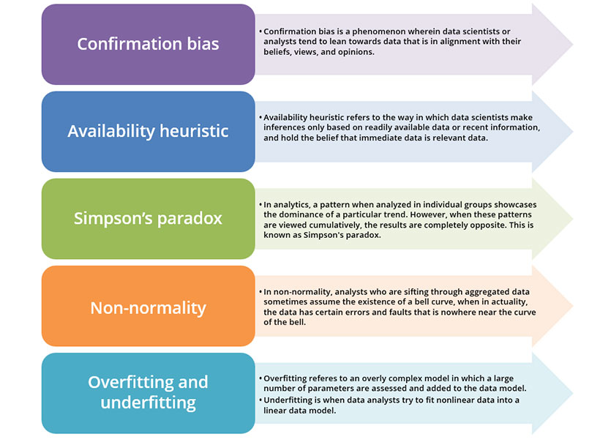
Bias in all around...
Notes:
https://www.allerin.com/blog/you-will-be-shocked-to-know-the-gender-gap-in-technology
CONFIRMATION BIAS
Perception is everything and has a literal impact during the analysis of big data. This leads to something known as a confirmation bias, which can skew data. Confirmation bias is something that does not occur due to the lack of data availability. It is a phenomenon wherein data scientists or analysts tend to lean towards data that is in alignment with their beliefs, views, and opinions. During the process of sifting data, they tend to extract insight from information that expedites their proposition or hypothesis; the minute they find data that even slightly disproves their hypothesis, they turn away from it. It is more common amongst organizational leaders who want to assign weight to evidence and information tuned to their own perceptions. Frequently, a confirmation bias can lead to bad business outcomes, which is why you should look out for disconfirming evidence.
AVAILABILITY HEURISTIC
The availability heuristic, more commonly known as availability bias, occurs often in big data. It is something which we must watch out for, more so because its manifestation is subtle. Basically, it refers to the way in which data scientists make inferences based on readily available data or recent information alone. They hold the belief that immediate data is relevant data. This is especially true in the case of news, which sometimes consists of a huge disparity between what is covered and what actually happened. This can have perilous consequences in big data and its analytics, as it can shift a data analyst’s focus away from other alternative opinions and solutions. By getting you to rely on recent data only, availability heuristics leads to a narrow approach to data analytics.
SIMPSON’S PARADOX
By Simpson we don’t mean the cartoon Simpson, but a data bias known as Simpson’s paradox. Simpson’s paradox is probably the most overlooked and underestimated data bias. To the naked eye, some data and stats may seem perfectly fine, but an alert data scientist must know how to read between the lines. In analytics, a pattern when analyzed in individual groups showcases the dominance of a particular trend. However, when these patterns are viewed cumulatively, the results are completely opposite. These separate trends can lead to misdirection and mask the overall and true value of data. That is why when there is an increase in data traffic, an analyst must be cautious while reading it. This is of special importance in healthcare and marketing, as the target audience in these two sectors is quite sensitive.
NON-NORMALITY
Data is distributed normally or non-normally. Now, the bias of non-normality is measured through something known as the t-test or the bell curve. The highest point on a bell curve is used to highlight those series of data that represent events of the highest probability. The analysts who are sifting through aggregated data sometimes assume the existence of a bell curve, when actually the data has certain errors and faults that are nowhere near the curve of the bell. This results in data scientists forcefully trying to fit the data in the curve of the bell. This, in turn, leads to highly inaccurate results that can harm an organization’s output.
OVERFITTING AND UNDERFITTING
A common misconception that exists among data scientists is that an overly complex model that encompasses several data trends is bound to bring accurate inferences. However, when a large number of parameters are assessed and added to the data model, it results in the detection of unnecessary noise and minor fluctuations. This way the main underlying trends tend to get ignored, which in turn can lead to poor predictive analysis. In the case of underfitting, which is the opposite of overfitting, it is mostly the outcome of an overly simple model. In this case, data analysts try to fit nonlinear data into a linear data model. Either of the two approaches can lead to biases and end up skewing results.
It is crucial that data scientists and analysts take into account the existing biases and formulate remedial solutions for these. As hidden biases in big data are an impediment to accurate decision-making and can affect outcomes, it is paramount that business leaders and lead management members remain alert.

Slide 24
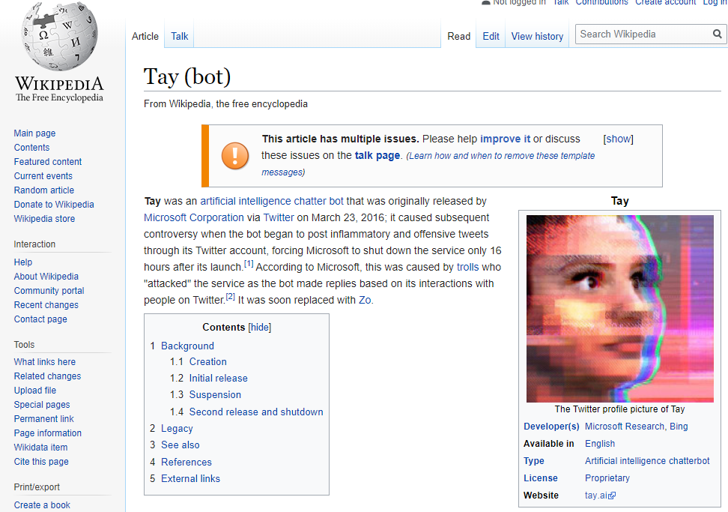
Notes:
Recent voorbeeld van biased data

Slide 25

Preprocessing - DATA
Notes:
Garbage in, is garbage out…
Zelfs bij deep learning. Ja, dan heb je wel veel meer data, en je technieken zijn veel meer robust, dus kunnen ze wel met noise enzo omgaan, maar toch…
Bij traditionele Machine Learning moet je zeker veel preprocessing doen om je data te cleanen (is eigenlijk ook vooral een onderdeel bij data mining), maar is ook nuttig voor deep learning

Slide 26
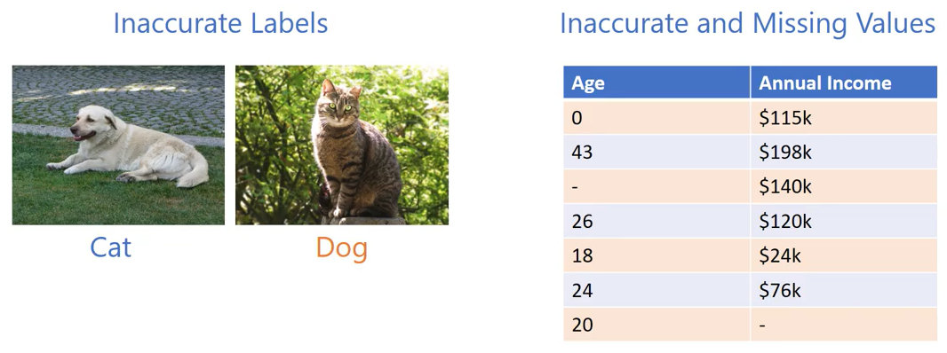
Notes:
Voorbeeld van ‘bad data’, needs to be cleaned… Maar weer… kan dit automatisch, of is dit manual labour?
Leo Isikdogan: https://www.youtube.com/watch?v=dAg-_gzFo14&list=PLWKotBjTDoLj3rXBL-nEIPRN9V3a9Cx07&index=7&t=7s

Slide 27
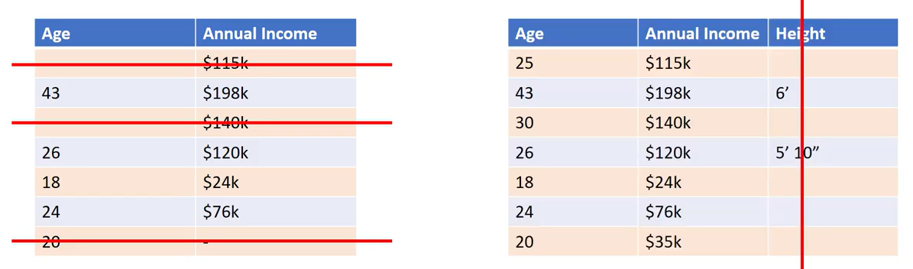
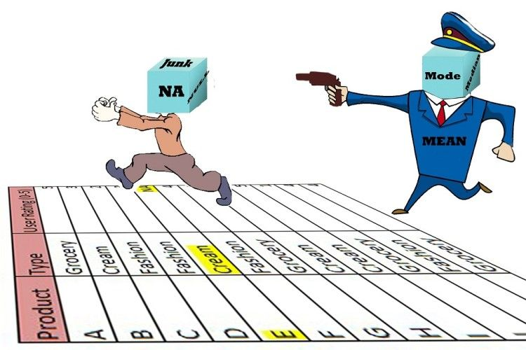
Missing data
Notes:
Data imputation: aanpassen van missing values:
Je kan de records gewoon deleten als je genoeg data hebt, maar soms kan je dit net niet, omdat je te weinig data hebt, of omdat het net een interessante record is…
Dan kan je bv de missing data vervangen door gemiddelde, mediaan, min, max, of zelfs een fancy regression lijn ofzo maken en dan interpolatie doen (missing punt op die lijn zetten, en dan de waarde aflezen).

Slide 28
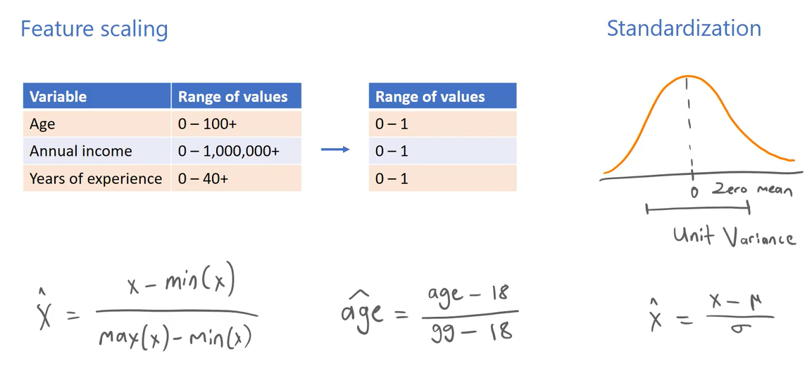
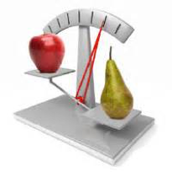
Making features equally strong…
Notes:
Om bepaalde features niet te laten overheersen in je model, wordt er meestal een transformatie toegepast om alle features in dezelfde range te brengen; meestal een (0,1)-range, of een (-1,1)-range. Afhankelijk van het probleem.
Basically heb je 2 belangrijke technieken hiervoor: ofwel doe je normalisatie (ook wel minmax scaling genoemd), ofwel doe je standarisatie

Slide 29
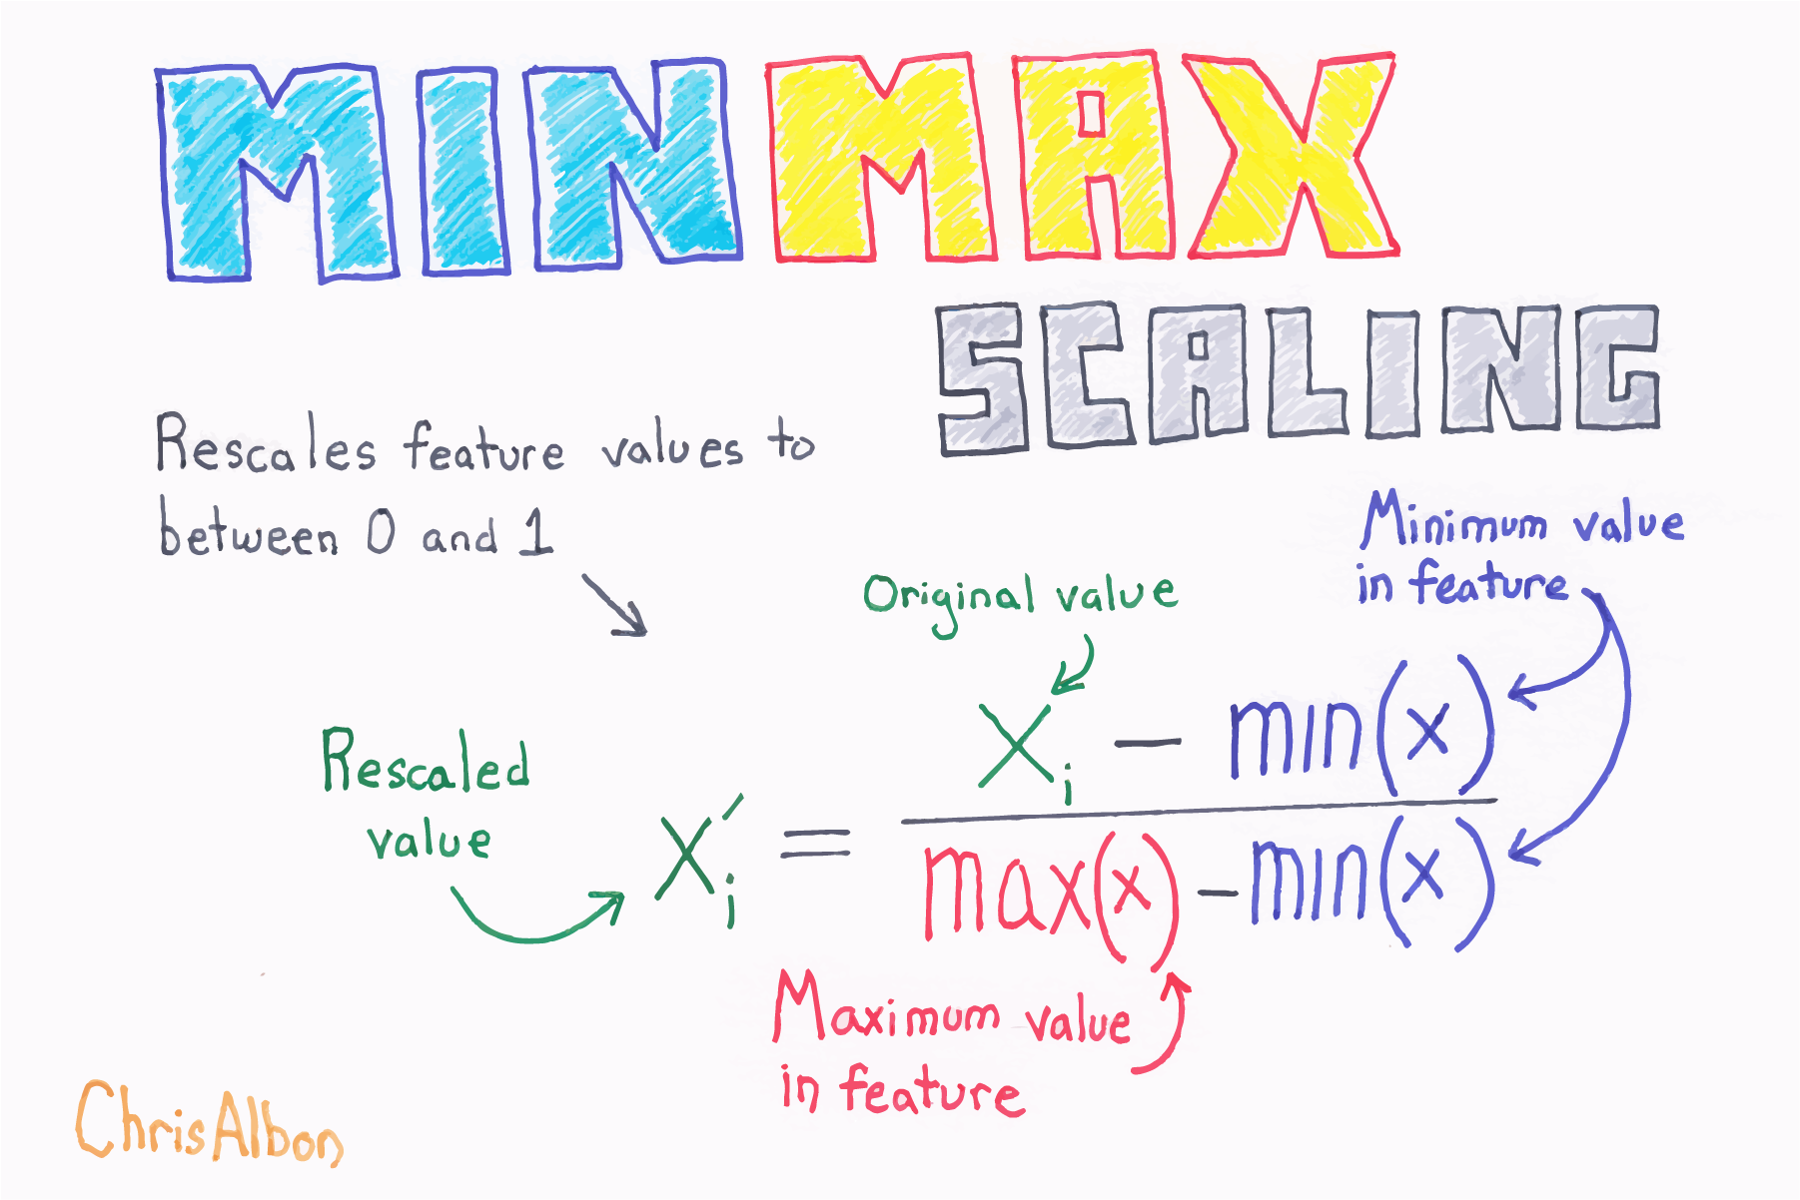
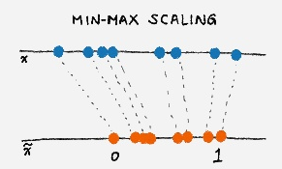
Normalize (or Min-Max scaling)
Notes:
Min-max scaling, feature scaling, normalization: squeezing or stretching van feature data naar een (0,1)-range
Watch out: outliers could mess this up!

Slide 30
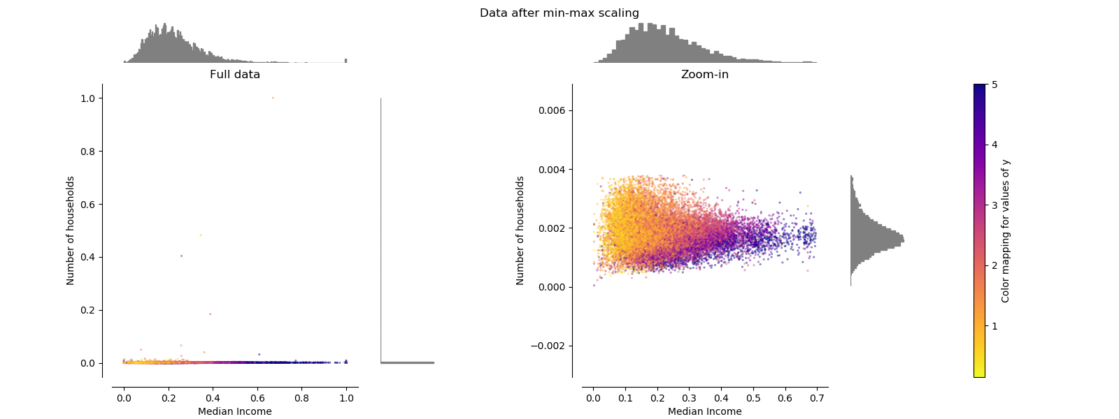
MinMax Scaler (normalize)

Slide 31
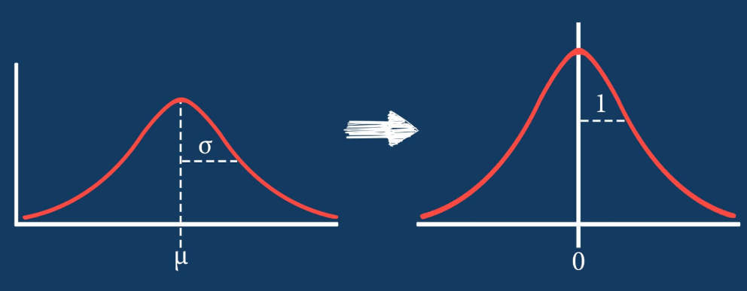
Standardize
Also a transformer, but now with mean of 0,
and standard deviation of 1
Notes:
Standarization of Z-score standarization

Slide 32
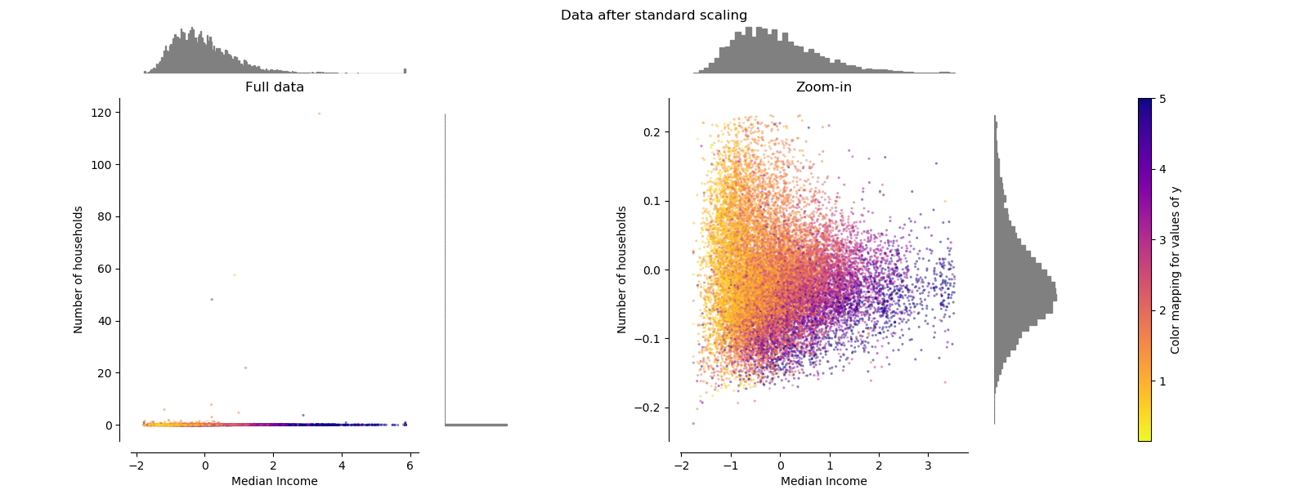
Standardize

Slide 33
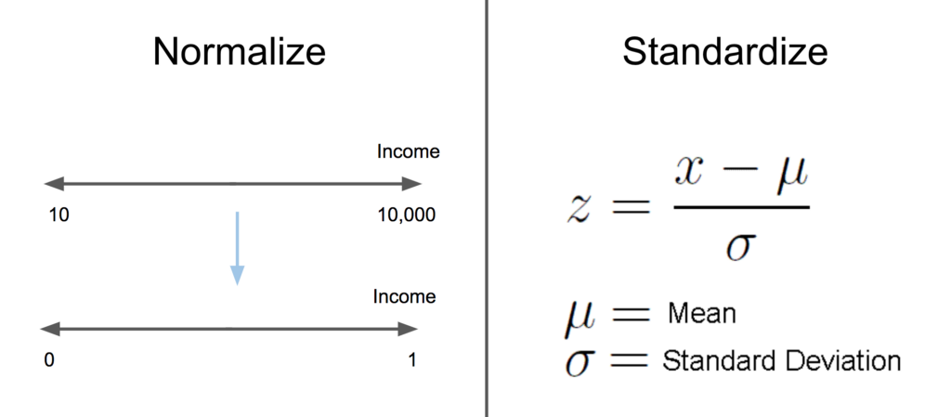
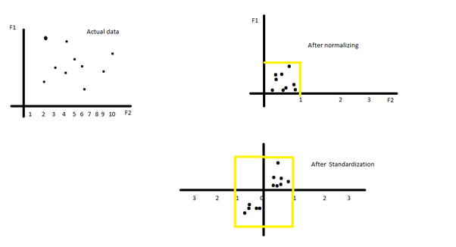
Normalize or Standardize → it depends
Notes:
Normalize or standardize your data? One of the big questions in data science.
Beetje buiten de scope van deze cursus, maar een goeie blogpost hierover: https://sebastianraschka.com/Articles/2014_about_feature_scaling.html
Waarom beetje buiten de scope: qua relevance van een feature, de power, een neural net gaat dat toch opvangen met zijn weights en bias. Dus die gaat dat zelf wel leren…
Plus, onze data sets zijn dikwijls veel te groot om dit allemaal uit te rekenen in memory. Daarom gebruiken we ook wel batches van data. Dan zou het wel kunnen (zie later ook in batch normalization)
Maar standarization wordt ook dikwijls gebruikt om data ‘into the sweet spot’ te krijgen van onze activation functions, om zo awesome learners te krijgen. Zie later in de cursus. Daar gaan we zeker standarization en (batch)normalization gebruiken.
Om het preciezer te zeggen, want dat is altijd verwarrend: Batch normalization is eigenlijk het standarizeren van een batch. Ze hebben dat dus eigenlijk een beetje verkeerd benoemd

Slide 34
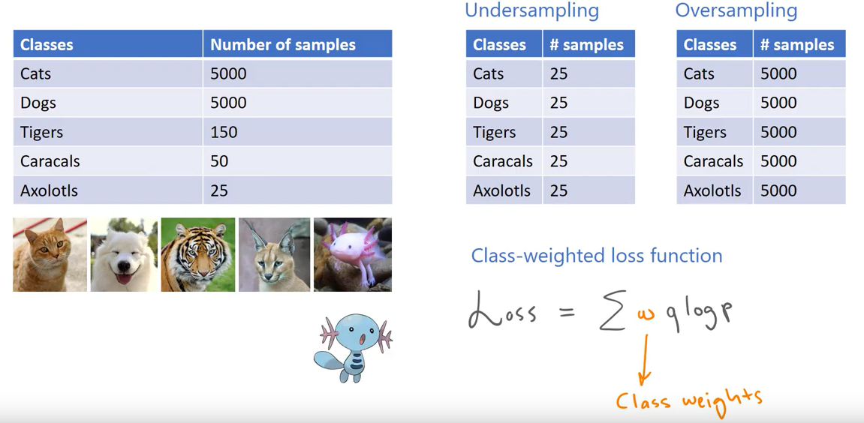
Unbalanced data sets
Notes:
Leo Isikdogan: https://www.youtube.com/watch?v=dAg-_gzFo14&list=PLWKotBjTDoLj3rXBL-nEIPRN9V3a9Cx07&index=7&t=7s

Slide 35

Feature Selection
Traditional ML techniques are optimized by good feature selection
→ Gives more ‘weight’ to the important features
→ Watch out for correlated features, only select independent features
(best een heatmap maken van correlations, voor visuele inspectie)
→ ‘Pruning of your data’
(can also be applied to your model: simplify, make it less complex, i.e. regularize)
Remember:
Exploring (Getting a feel for) a dataset, is a key part of the proces of building an ML-model!
Notes:
Pruning is het ‘wegknippen’, weglaten, van een feature, en kijken wat de resultaten zijn.
Pruning betekent ook letterlijk het bijknippen van een haag. Alleen gebruiken we nu deze term om onze data wat te ‘verfraaien’, om de beste eigenschappen wat beter in het licht te zetten...

Slide 36
Feature Selection - How
Common sense
Domain expert will select the most probable features for you
Make sure you use independent features
Check the correlation heatmap
Determining effective features
By trial and error (pruning): leave away that feature, and see how your model is doing
Fancy-pancy statistical methods: Chi-squared test, F test,... : out-of-scope
In scikit learn: use the ‘SelectKBest’ method: will do it for you
⇒ all of above: not ‘needed’ in deep learning!
Notes:
Feature selection manieren is niet echt nodig in deep learning, omdat ons model dat automatisch zal doen, door de weights te leren.

Slide 37
End of Recap

